Slide 1
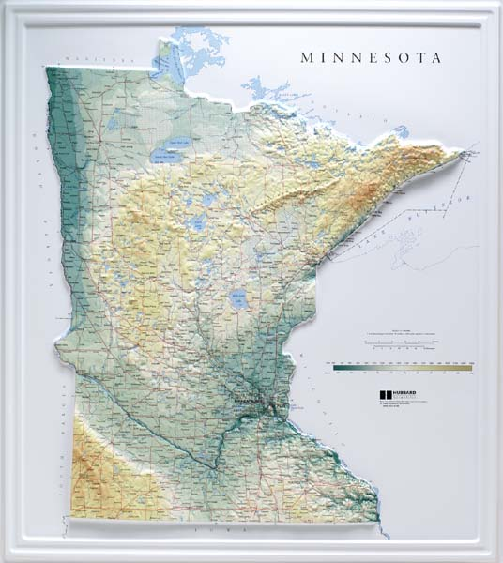
1) What are some of the landforms we have in MN?
2) How did those landforms form/get that way?

Slide 2
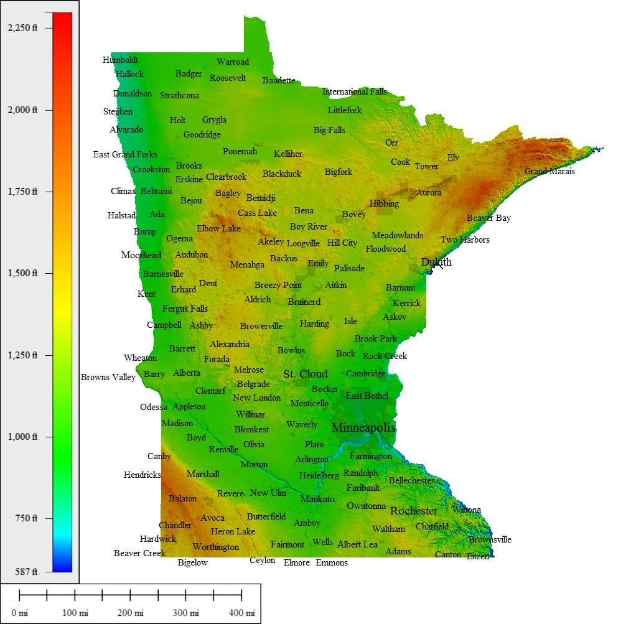
1) What are some of the landforms we have in MN?
2) How did those landforms form/get that way?

Slide 3
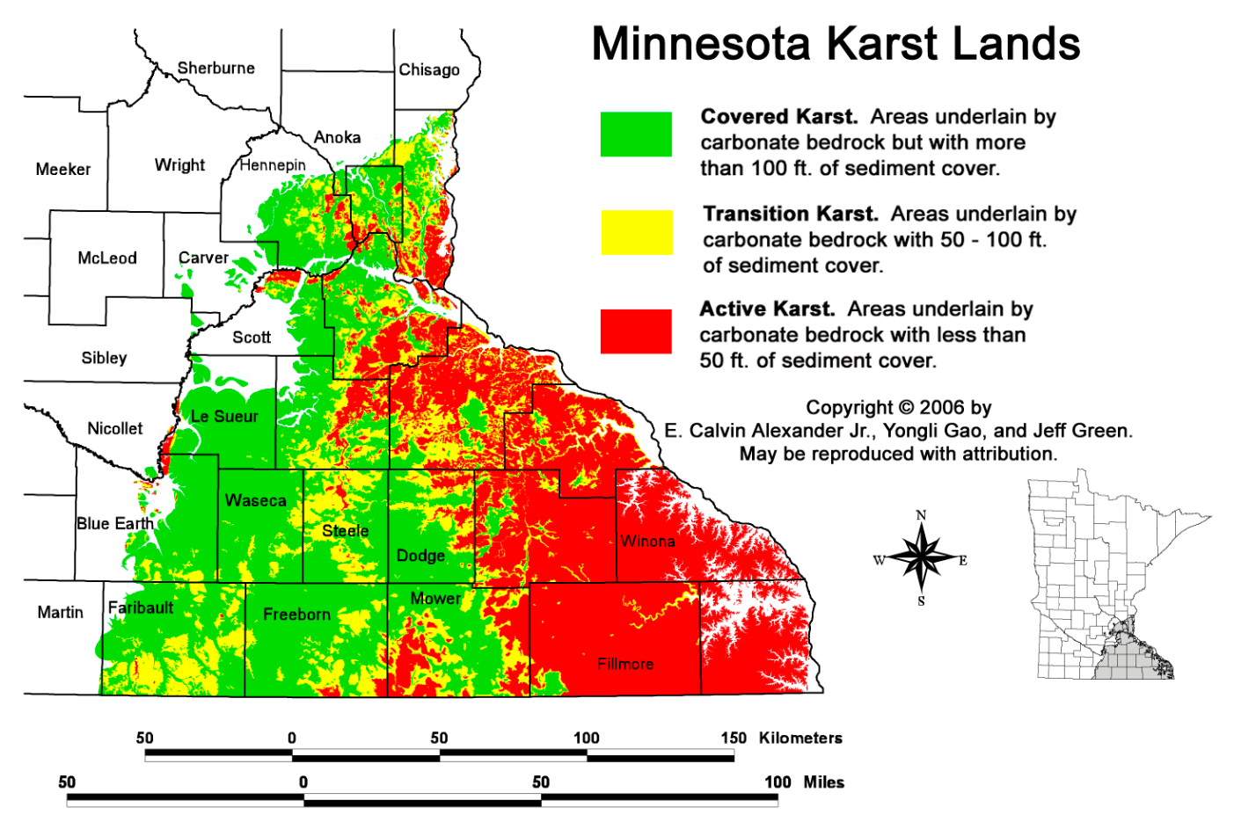

Slide 4
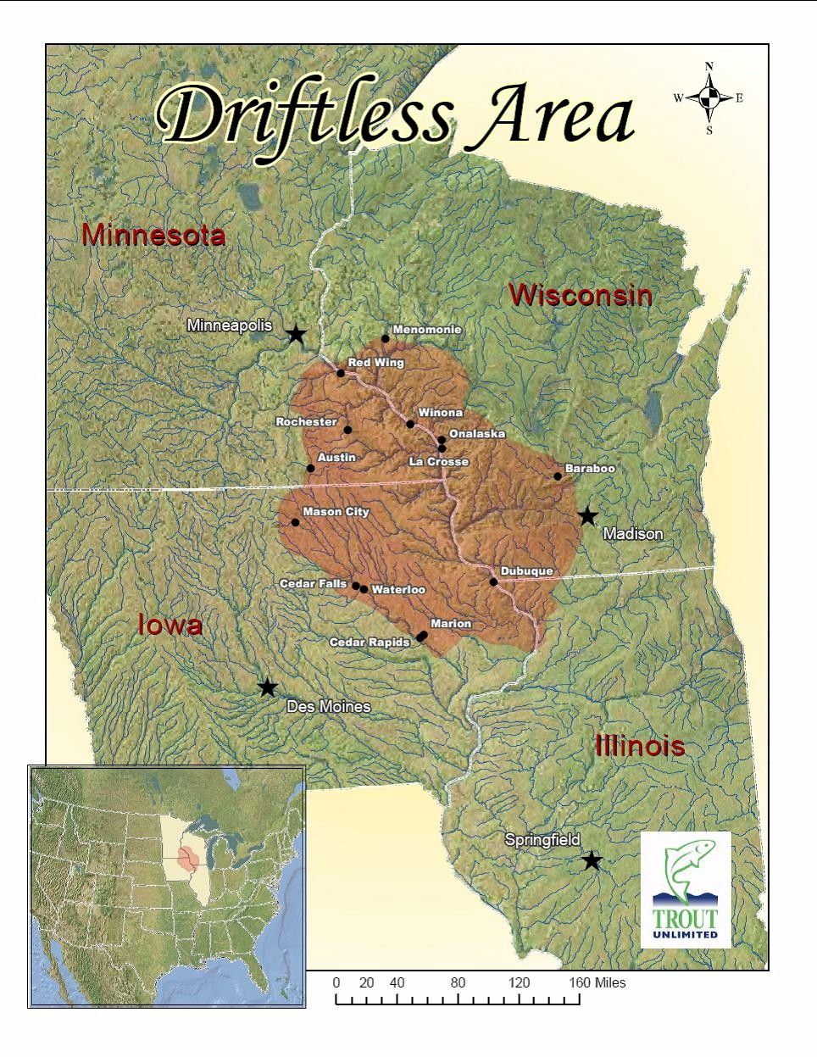

Slide 5
Unit 3: Earth’s Surface

Slide 6
Brainstorm
How would Earth change if it was covered with all water?
What percent of Earth is covered with water? Of Earth’s water, what percent is fresh? Where is most freshwater found?
How would Earth change if it was all covered with land?
What are some of the surfaces that cover Earth’s land?
How would Earth change if it was all covered with blacktop and cement?

Slide 7
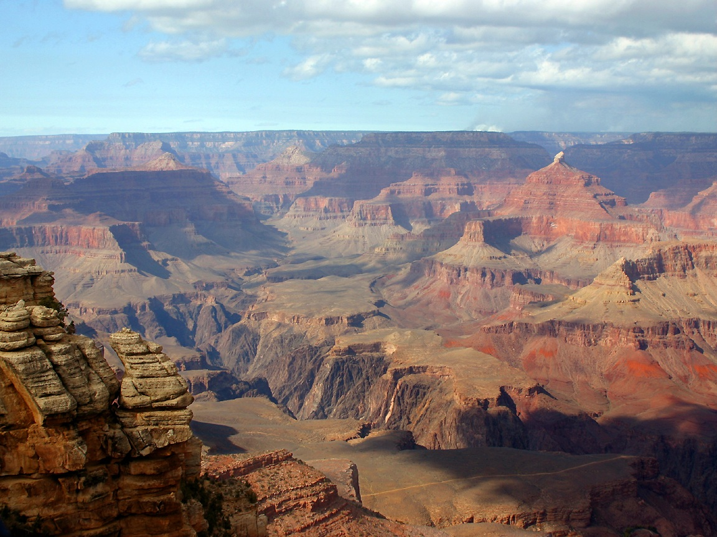

Slide 8
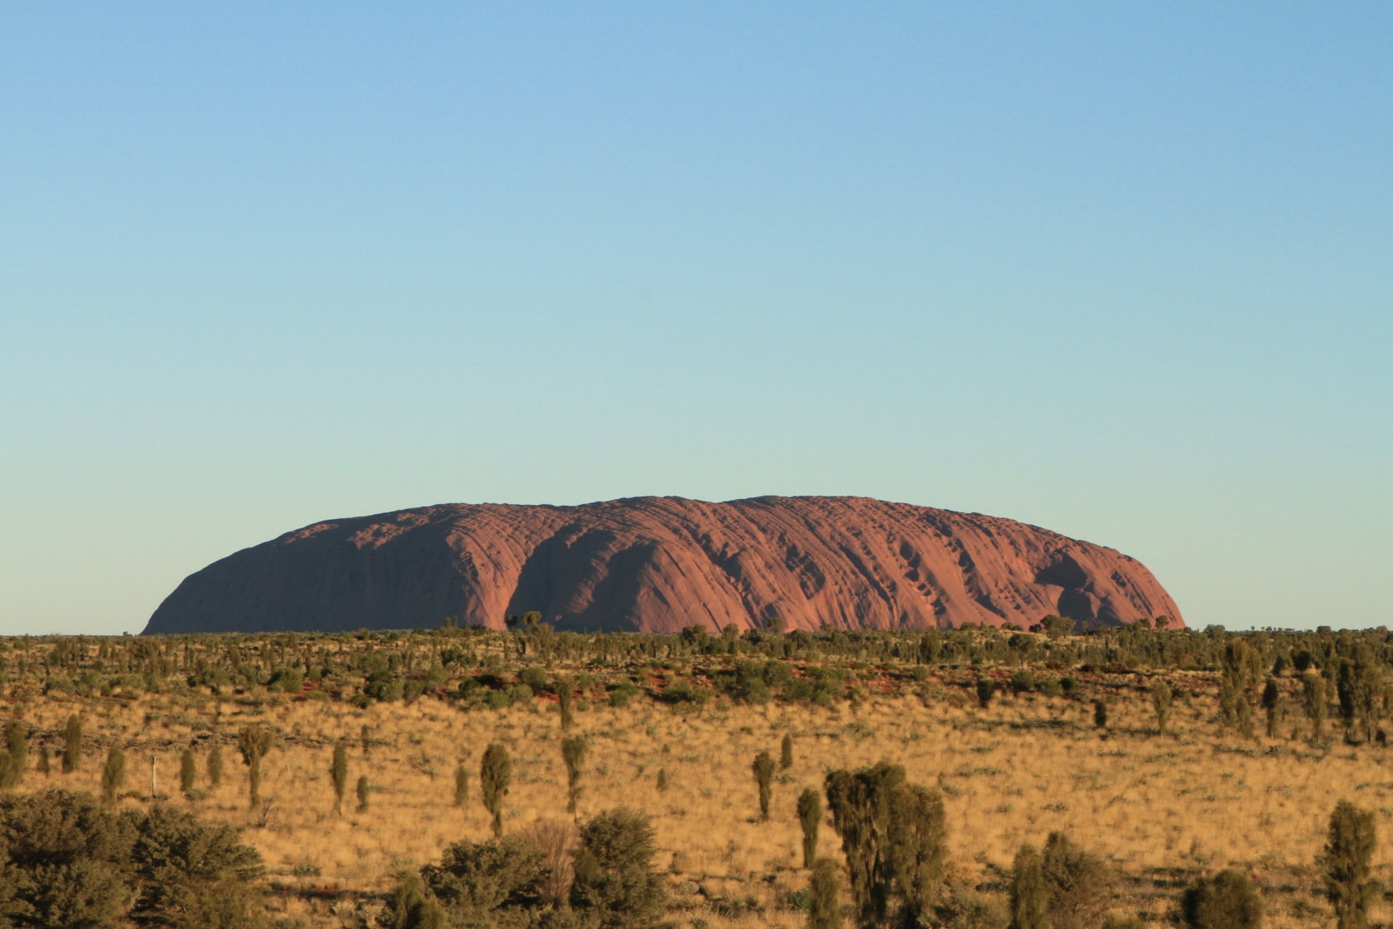

Slide 9
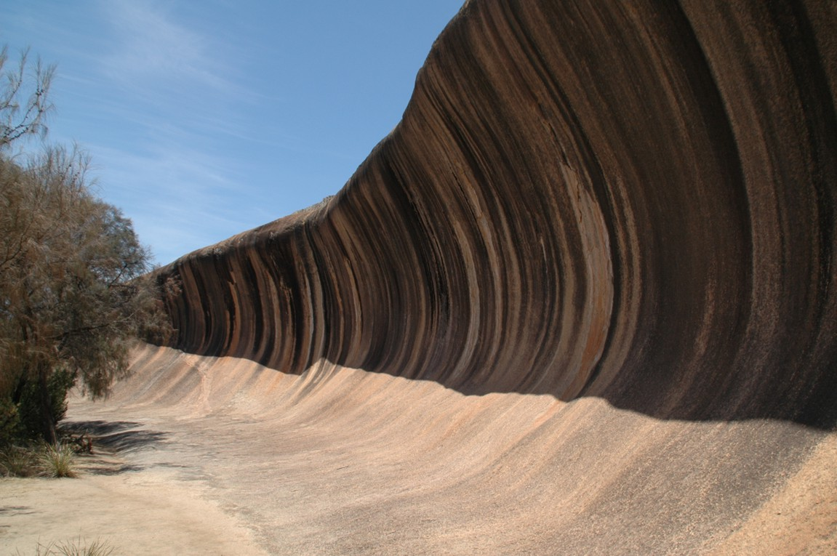

Slide 10
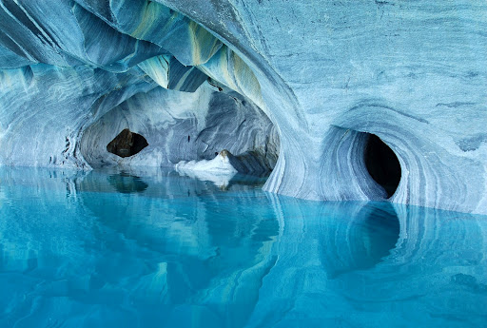

Slide 11
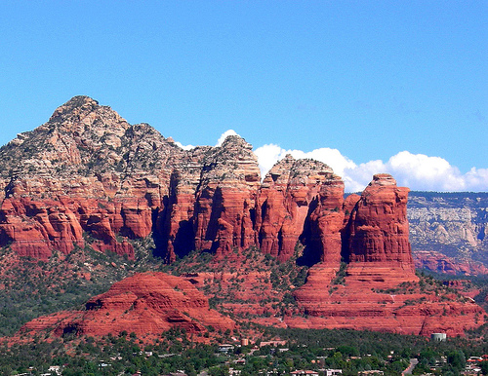

Slide 12
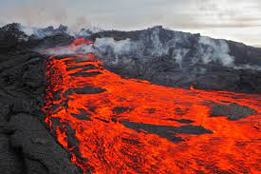
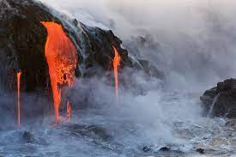
Constructive forces
Processes that build up or make land.

Slide 13
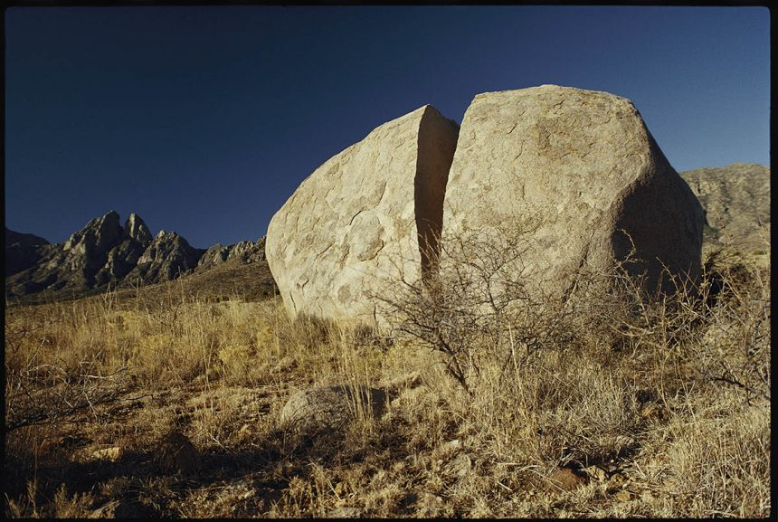
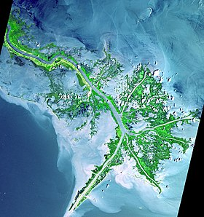
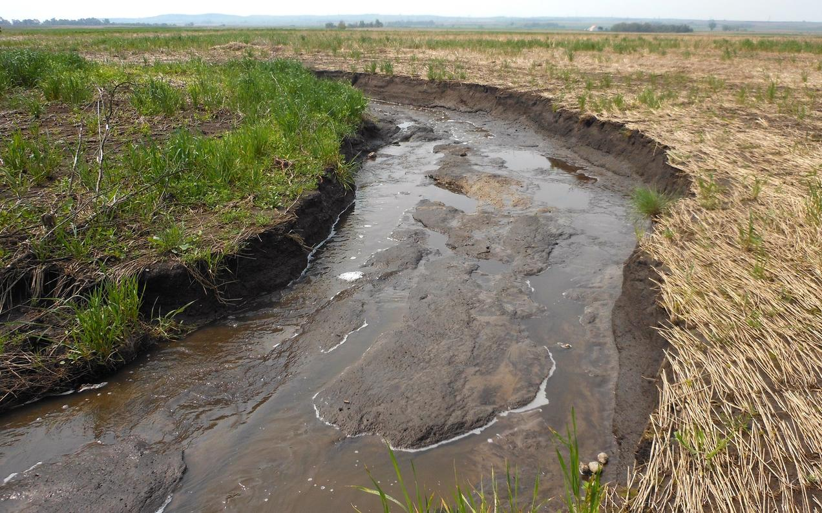
Destructive forces
Processes that break down land.
Weathering-wearing away at land
Erosion-carrying away sediment
Deposition-releasing sediments to another area

Slide 14
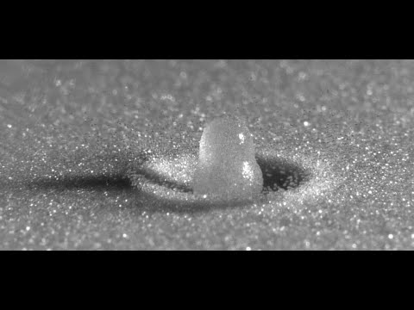
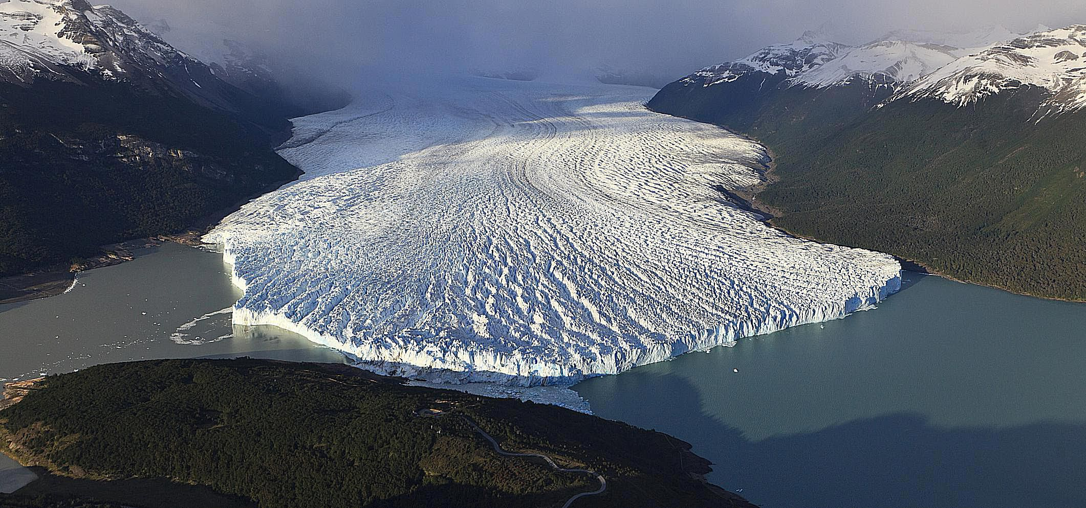
Changing Earth’s Surface
Water (waves, precipitation, frost)
Wind
Glaciers

Slide 15
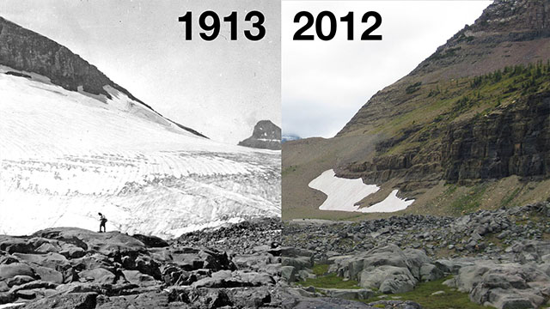

Slide 16
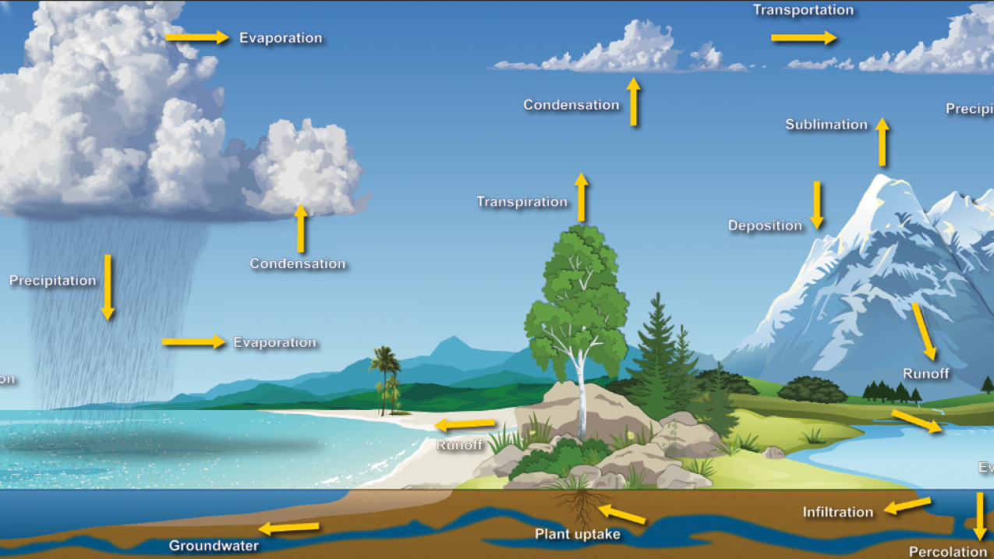

Slide 17
Law of Superposition
Rock layers lower in the column are older than those towards the surface.

Slide 18
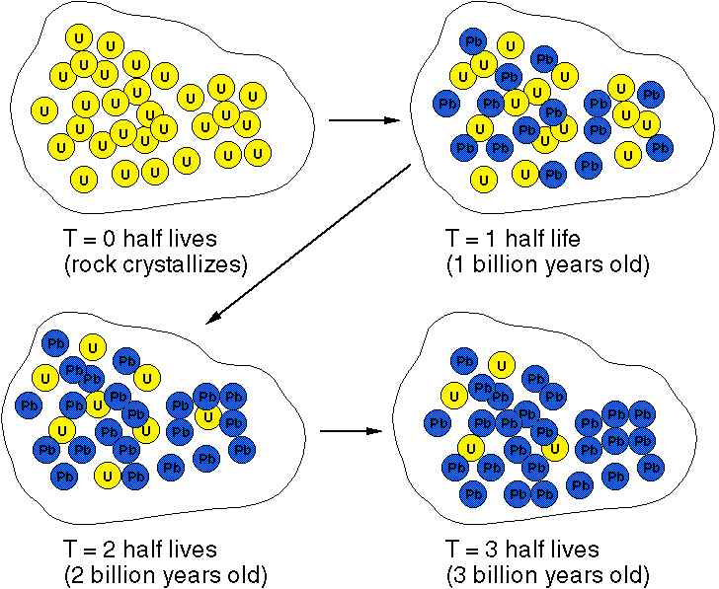
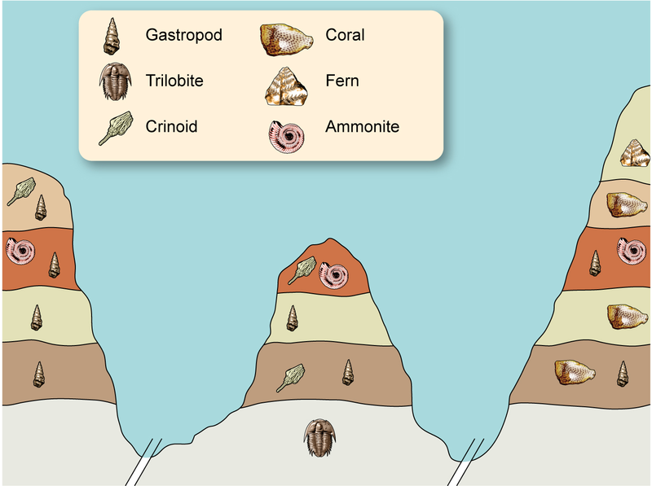
Telling a story
Relative dating-describing the ages of layers of rock in an area
Radiometric dating-a scientific way to get an actual age/number to how old a rock is.

